Slide 1
Trees Data Structure

Slide 2
Other data structures such as arrays, linked list, stack, and queue are linear data structures that store data sequentially.
A tree is also one of the data structures that represent hierarchical data. It is non-linear data structures that store data in hierarchical manner.
Tree Terminologies
Node
A node is an entity that contains a key or value and pointers to its child nodes.

Slide 3
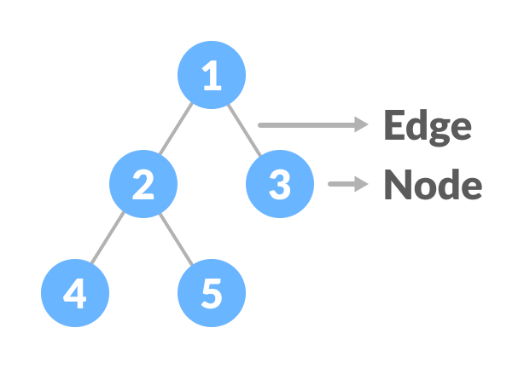
Edge
It is the link between any two nodes.

Slide 4
Root: The root node is the topmost node in the tree hierarchy.
Child node: If the node is a descendant of any node, then the node is known as a child node.
Parent: If the node contains any sub-node, then that node is said to be the parent of that sub-node.
Sibling: The nodes that have the same parent are known as siblings.

Slide 5
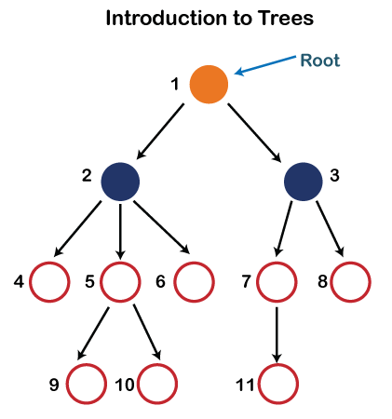
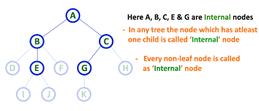
Leaf Node:- The node of the tree, which doesn't have any child node, is called a leaf node. A leaf node is the bottom-most node of the tree. Leaf nodes can also be called external nodes.
Internal nodes: A node has at least one child node known as an internal

Slide 6
Ancestor node:- An ancestor of a node is any predecessor node on a path from the root to that node. The root node doesn't have any ancestors.
In the tree shown in the above image, nodes 1, 2, and 5 are the ancestors of node 10.
Descendant: The immediate successor of the given node is known as a descendant of a node. In the above figure, 10 is the descendant of node 5.

Slide 7
Height of a Node
The height of a node is the number of edges from the node to the deepest leaf (ie. the longest path from the node to a leaf node).
Depth of a Node
The depth of a node is the number of edges from the root to the node.

Slide 8
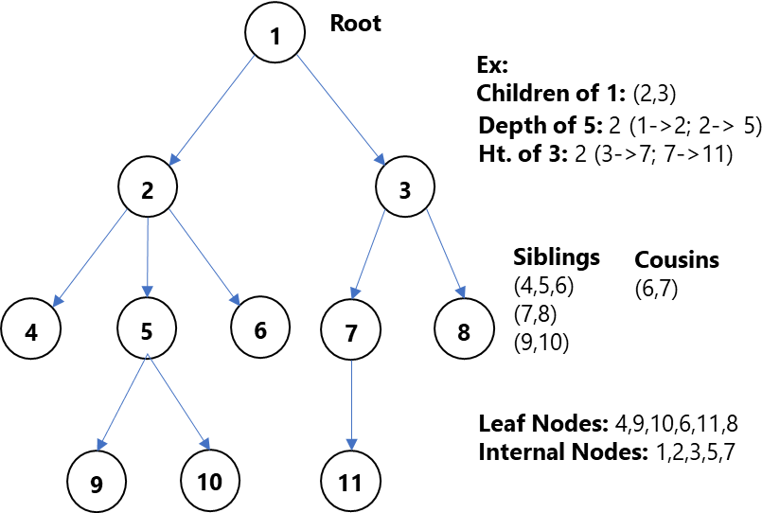

Slide 9
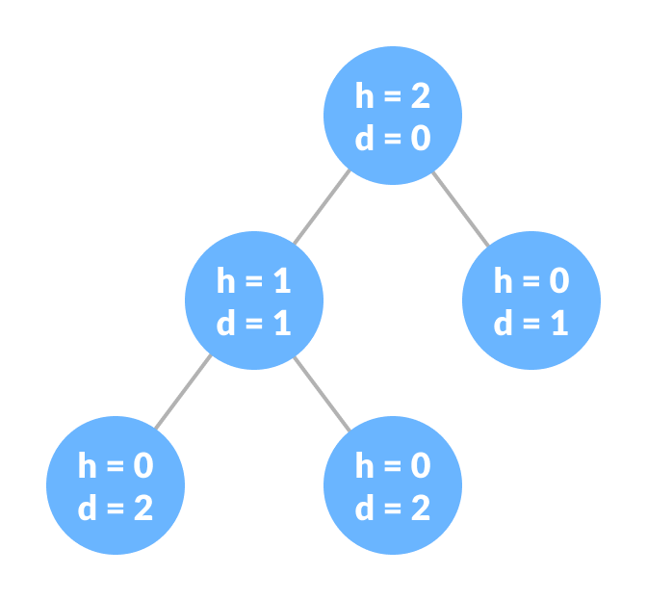
Height of a Tree
The height of a Tree is the height of the root node or the depth of the deepest node.

Slide 10
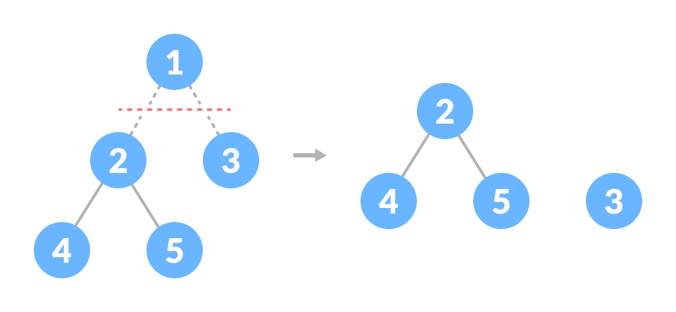
Degree of a Node
The degree of a node is the total number of branches of that node.
Forest
A collection of disjoint trees is called a forest.
You can create a forest by cutting the root of a tree.
Key: It represents the value of a node.

Slide 11
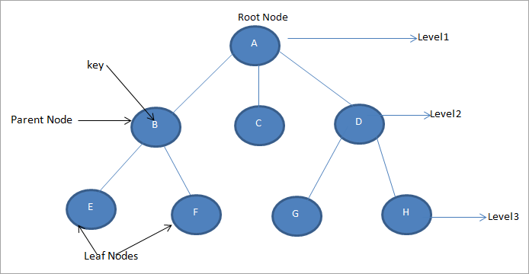
Level: Represents the generation of a node. A root node is always at level 1. Child nodes of the root are at level 2, grandchildren of the root are at level 3 and so on. In general, each node is at a level higher than its parent.

Slide 12
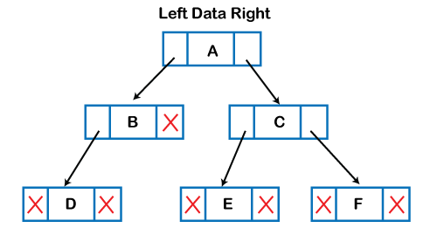
Implementation of Tree

Slide 13
struct node
{
int data;
struct node *left;
struct node *right;
}

Slide 14
Types of Tree
Binary Tree
Binary Search Tree

Slide 15
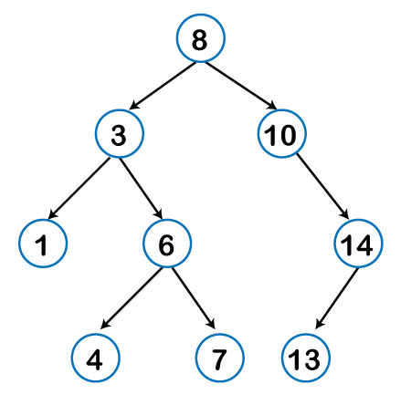
Binary tree: Here, binary name itself suggests two numbers, i.e., 0 and 1. In a binary tree, each node in a tree can have utmost two child nodes. Here, utmost means whether the node has 0 node, 1 node or 2 nodes.

Slide 16
A node can be connected to the utmost two child nodes in a binary search tree.
Every node in the left subtree must contain a value less than the value of the root node, and the value of each node in the right subtree must be bigger than the value of the root node.

Slide 17
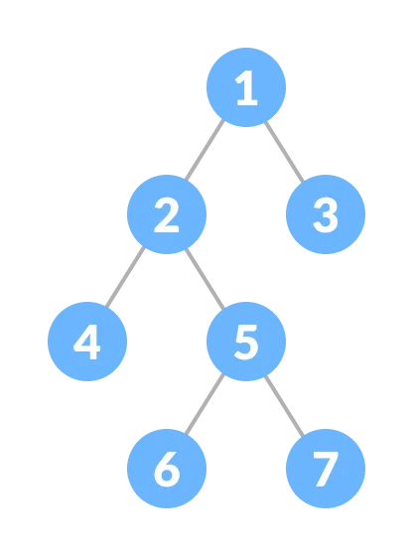
Full Binary Tree A Binary Tree is a full binary tree if every node has 0 or 2 children. We can also say a full binary tree is a binary tree in which all nodes except leaf nodes have two children.
18
/ \
15 30
/ \ / \
40 50 100 40

Slide 18
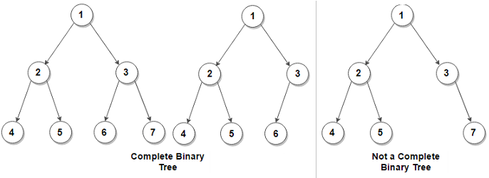
Complete Binary Tree: A Binary Tree is a Complete Binary Tree if all the levels are completely filled except possibly the last level and the last level has all keys as left as possible
18
/ \
15 30
/ \ / \
40 50 100 40
/ \ /
8 7 9

Slide 19
Perfect Binary Tree A Binary tree is a Perfect Binary Tree in which all the internal nodes have two children and all leaf nodes are at the same level. 18
/ \
15 30
/ \ / \
40 50 100 40
In a Perfect Binary Tree, the number of leaf nodes is the number of internal nodes plus 1
L = I + 1 Where L = Number of leaf nodes, I = Number of internal nodes.

Slide 20
A degenerate (or pathological) tree A Tree where every internal node has one child. Such trees are performance-wise same as linked list.
10
/
20
\
30
\
40

Slide 21
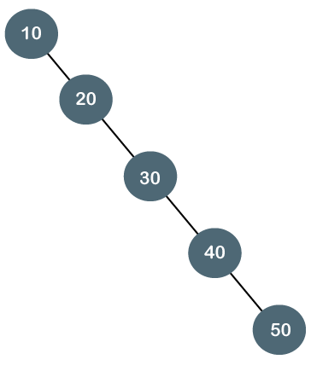
Degenerate binary tree through examples.
The above tree is a degenerate binary tree because all the nodes have only one child. It is also known as a right-skewed tree as all the nodes have a right child only.

Slide 22
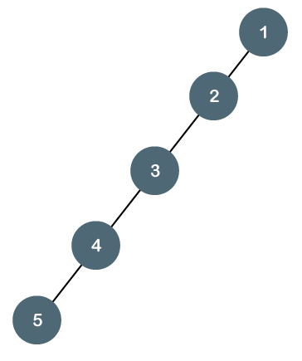
The above tree is also a degenerate binary tree because all the nodes have only one child. It is also known as a left-skewed tree as all the nodes have a left child only.

Slide 23
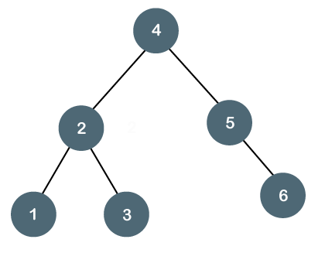
Balanced Binary Tree
The balanced binary tree is a tree in which both the left and right trees differ by at most 1. {0,-1,1} For example, AVL and Red-Black trees are balanced binary tree.
The above tree is a balanced binary tree
because the difference between the left
subtree and right subtree is zero.

Slide 24
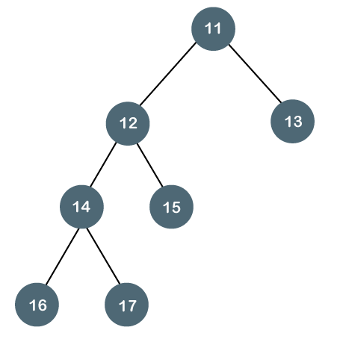
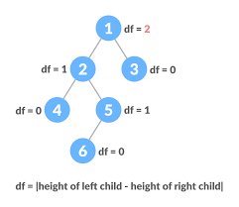
The above tree is not a balanced binary tree because the difference between the left subtree and the right subtree is greater than 1.

Slide 25
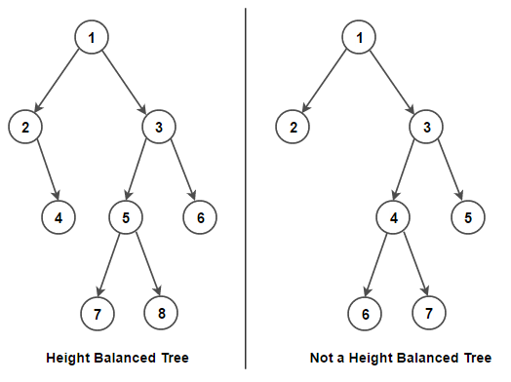

Slide 26
Tree Traversal
In order to perform any operation on a tree, you need to reach to the specific node. The tree traversal algorithm helps in visiting a required node in the tree.
Inorder traversal
Preorder traversal
Postorder traversal

Slide 27
